Slide 1
Burkholderia Pseudomallei
Name
Institution
Date

Slide 2
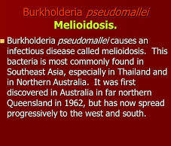

Slide 3
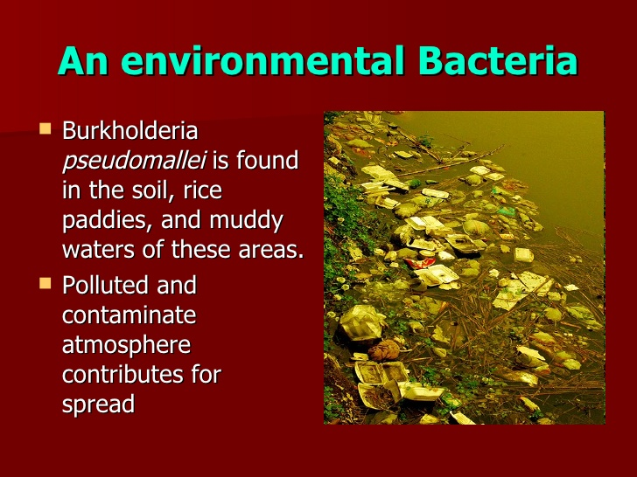
Natural habitat/Environment
Soil
Rice paddies as well as
Stagnant waters (Torres and Steinmetz, 2011)

Slide 4
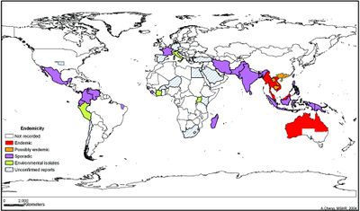
Region where it can be found.
Tropical and subtropical regions;
Thailand, Malaysia, Singapore and Northern Australia
Southeaast Asia, South Asia and China
Papua Guinea and New Caledonia

Slide 5
Reservoir
the soil
contaminated water
predominant during rainy season (Torres et al., 2011)

Slide 6
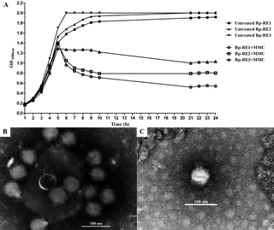
Host Range
dependant on the phages (Gatedee et al, 2011)
isolation of a podovirus

Slide 7
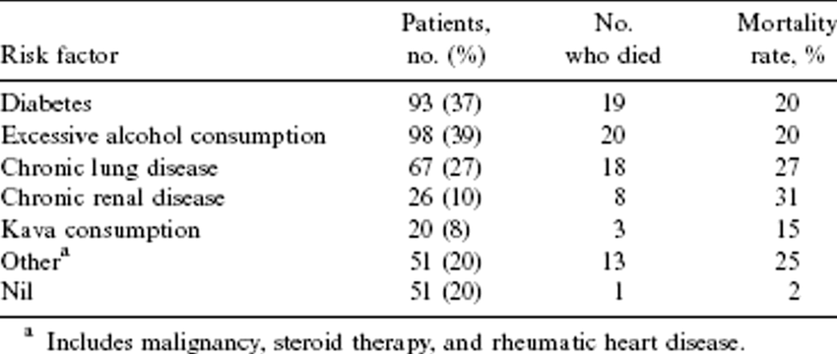
Predisposing & Occupational Risks, Disease? Infectious Dose?
Predisposing risks; smokers, diabetic patients, alcohol abusers, chronic renal and lung diseases, liver infections, thalassemia, kava consumption and cancer (Torres et al., 2011)
Occupational risks; people working or staying in Southeast Asia and Northern Australia as well as other
Infectious dose- 10 colony forming units

Slide 8
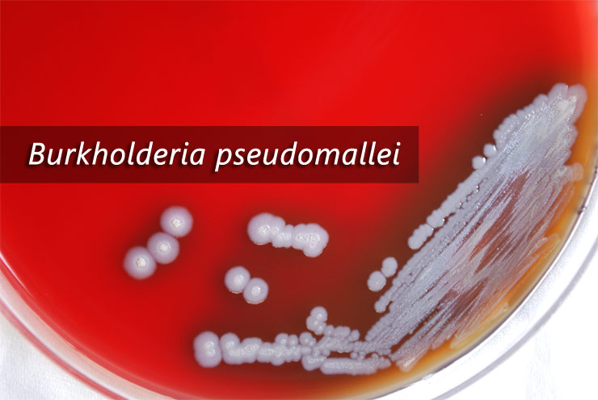
Mode of transmission?
soil and surface waters
inhaling dust or water droplets

Slide 9
References
Gatedee et al. (2011). Isolation and Characterization of a Novel Podovirus which Infects Bukholderia Pseudomallei. Virolohy Journal. Retrieved from https://www.biomedcentral.com/track/pdf/10.1186/1743-422X-8-366?site=virologyj.biomedcentral.com on November 9, 2017.
Torres, A & Steinmetz, I. (2011).Recent Progress in Melioidosis and Glanders. Frontiers E-books Publishers.

